Slide 1

Project 3: Market Basket analysis
Elvessa Tatum

Slide 2
Background info
Apriori is an algorithm used to find frequent itemsets and generate association rules in a dataset, often used for Market Basket Analysis.
The core idea is that frequent patterns (item combinations) can be expanded one item at a time, and all subsets of a frequent itemset must also be frequent.
The 2 basic Operations of Apriori are the Join step and the Prune step
Join Step — Join sets of items together to create larger candidate sets.
Prune Step — Eliminate candidate sets that contain infrequent subsets.
The Apriori principle states the following:
If an itemset is frequent, then all of its subsets must also be frequent
If an itemset is not frequent, then all of its supersets cannot be frequent
The support of an itemset never exceeds the support of its subsets
Overfitting can be reduced by setting appropriate minimum support and confidence thresholds, and by filtering rules for relevance (e.g., high lift values), rather than keeping all possible rules.
The benefits are that Apriori is an easy to understand algorithm, and join and prune steps are easy to implement on large itemsets in large databases
Some issues with Apriori is it requires high computation if the itemsets are very large and the minimum support is kept very low. Also, the entire database needs to be scanned.

Slide 3
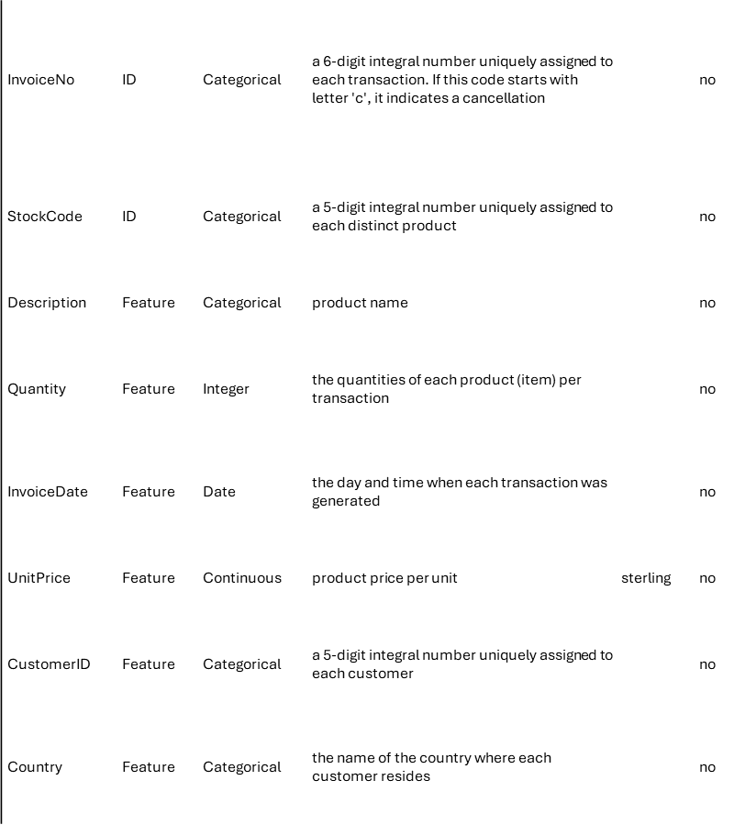
Our Purpose and Dataset information
Today, I plan on using the UCI Online Retail Dataset to discover patterns in customer purchasing behavior through Market Basket Analysis. This dataset contains transactional data from an online retail store registered in the United Kingdom, covering purchases made between December 1, 2010 and December 9, 2011. Each observation represents an item purchased in a specific invoice, allowing for detailed tracking of buying habits, returns, and overall spending behavior.
This dataset was chosen because it is relatively simple, with only six main features (these can be seen to the right), yet large enough to provide rich insights due to its thousands of recorded transactions. Its structure makes it ideal for applying association rule mining without overwhelming complexity.
The primary goal of this project is to find frequent item combinations that customers often purchase together and generate meaningful association rules. To achieve this, I will use the Apriori algorithm, which is well-suited for this type of analysis because it systematically finds frequent patterns while minimizing computational cost through smart pruning strategies. I chose Apriori over other models like FP-Growth because it is easier to interpret and provides a clear view of the frequency relationships between items. Ultimately, these findings could help improve product placement strategies, bundling, and targeted marketing.

Slide 4
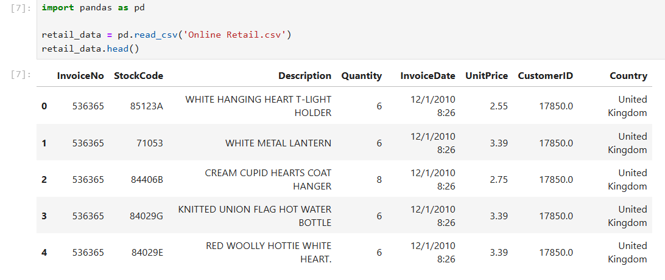
Importing Data
Let’s take a look at our data from a glance

Slide 5
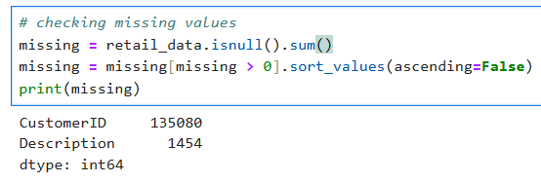
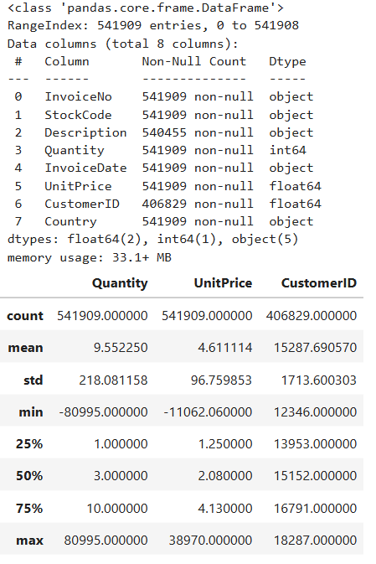
Importing data
Let’s use describe and info, and check for missing values

Slide 6
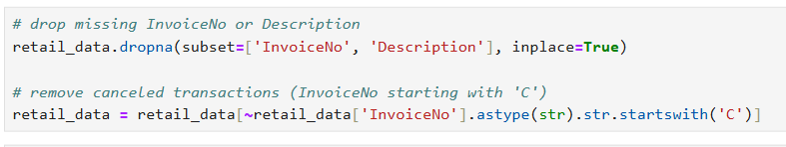
Data pre-processing
Let’s do some pre-processing by getting rid of missing values and canceled transactions

Slide 7
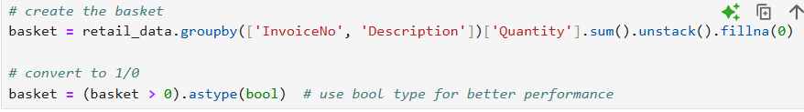
Data pre-processing continued
Let’s continue pre-processing by creating itemsets.

Slide 8
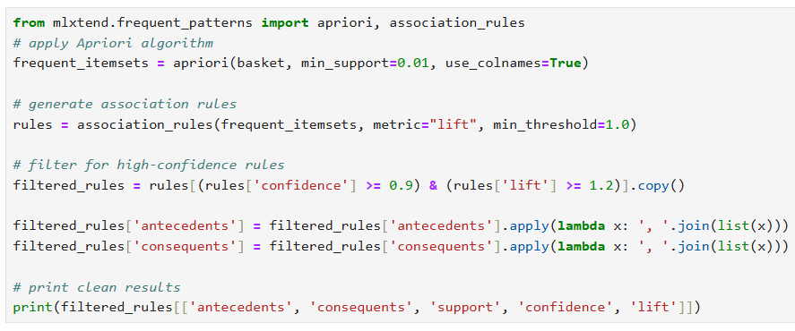
Data exploration and analysis
Let’s make some association rules and filter for high confidence and lift

Slide 9
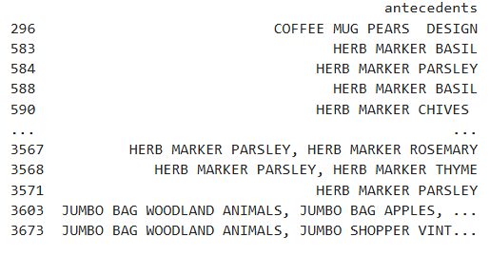
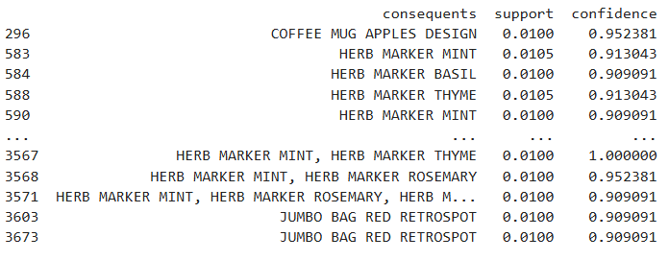
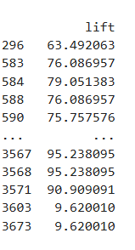
Data exploration and analysis continued
Let’s take a look at the itemsets created.

Slide 10
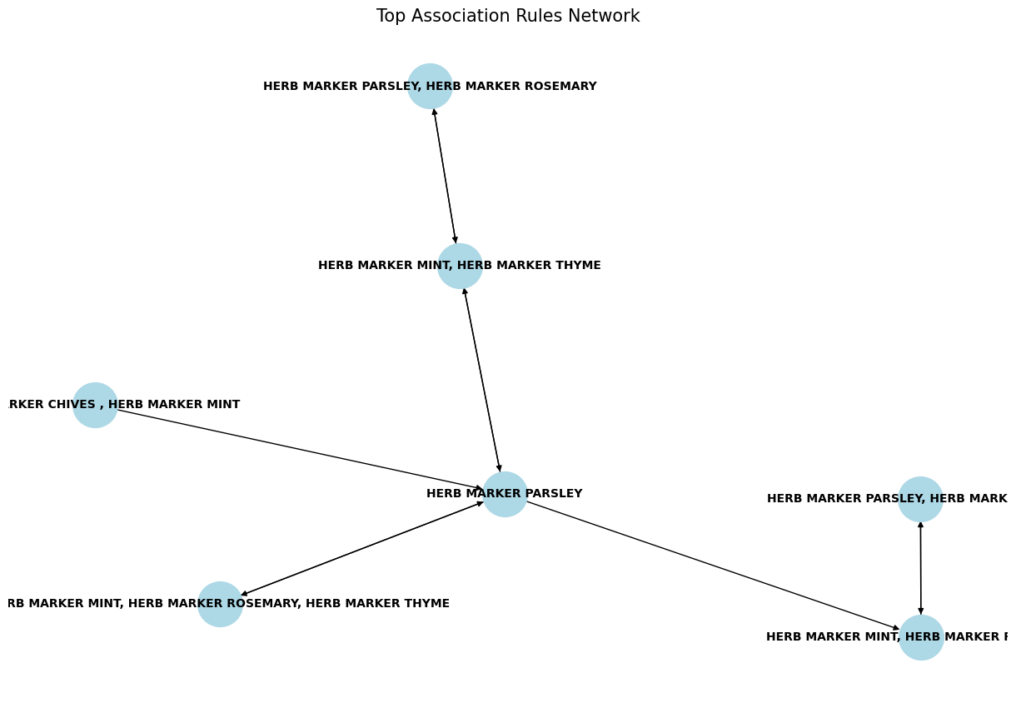
Data exploration and analysis continued
Let’s take a look at the best association rules network

Slide 11
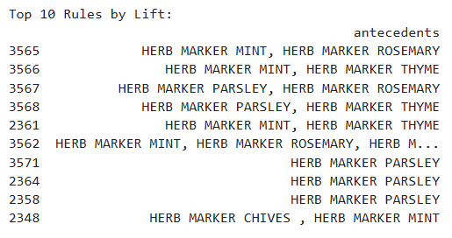
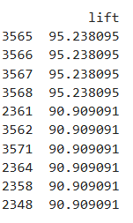
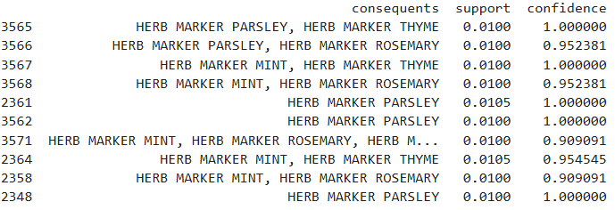
Data exploration and analysis continued
Finally, let’s look at the top 10 and top 5 rules by lift

Slide 12
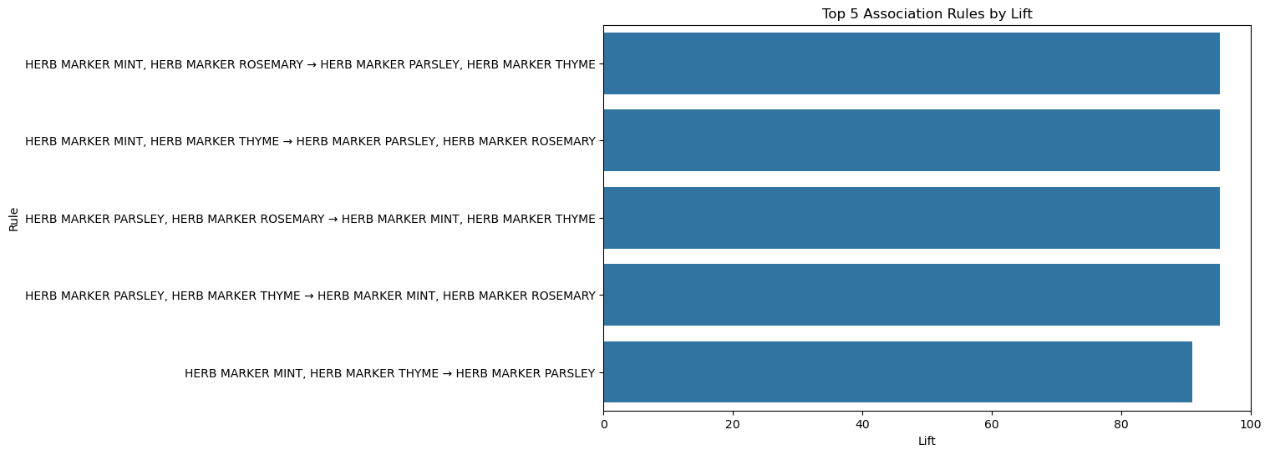
Data exploration and analysis continued

Slide 13
Conclusion
The analysis revealed that a significant number of the strongest association rules centered around herb marker products such as "HERB MARKER MINT," "HERB MARKER PARSLEY," "HERB MARKER ROSEMARY," and "HERB MARKER THYME." These items frequently appeared together in transactions with exceptionally high confidence and lift values, suggesting that customers who purchase one herb marker are extremely likely to purchase others as well. For example, some item combinations exhibited a confidence of 100% and a lift of over 90, indicating very strong and non-random associations.
These findings are valuable for business applications. Retailers could strategically bundle these herb markers together or offer targeted promotions to encourage bulk purchases, maximizing revenue per customer. Additionally, these insights could guide inventory management by highlighting which items are often purchased together, allowing for better stock planning.
Overall, the Apriori algorithm provided clear, actionable insights into customer buying patterns, demonstrating its strength as a tool for market basket analysis despite challenges such as memory demands and the need for careful parameter tuning to avoid overfitting.

